Slide 1
Superstore Sales Dashboard
Objective: To provide business stakeholders with a clear view of Sales, Profit, and Growth trends for informed decision-making.
Dataset: Superstore Data
Tools: Power BI

Slide 2
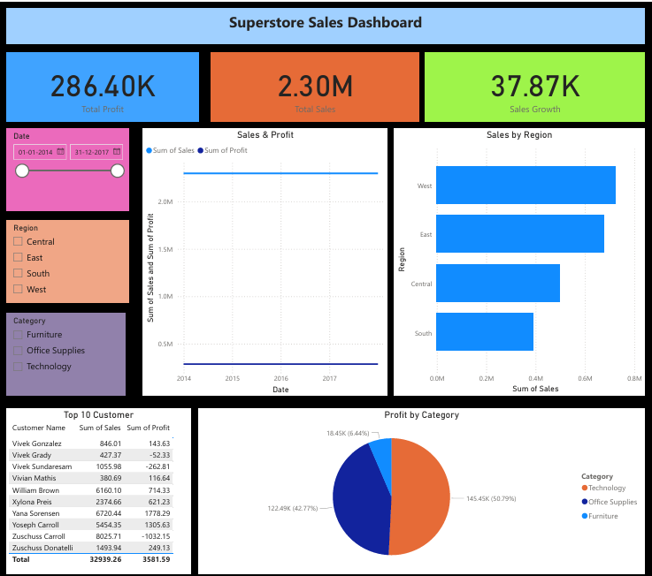

Slide 3
Key Insights
Sales Increased led by South Region
Sales and Profit led by Technology but Sales Growth Lowest

